Slide 1

Final Interview Preparation
Your Opportunity to Begin a Career Journey with Nestlé Lanka Pannala Factory Placement Program

Slide 2

Congratulations!
You Made It This Far
You have been selected from approximately 75+ applicants. Your journey so far:
75+ Applicants ➔ Assessments ➔ Group Assessment ➔ Final Interview
Reaching this stage means you have already demonstrated exceptional potential and capability. Be proud of this achievement.

Slide 3






What Happens Next?
The final interview is a two-way conversation. The panel wants to understand:
Motivation
Learning Agility
Skills & Teamwork
What drives you? We want to hear about your career aspirations and why you want to build your future with us.
Demonstrate your ability to learn quickly, adapt to new challenges, and apply past lessons to future situations.
Showcase your communication skills and how effectively you collaborate within a dynamic team environment.

Slide 4
What Makes a Strong Candidate?
Positive Attitude: Approach challenges with optimism and a solution-oriented mindset.
Confidence: Believe in your skills and experiences, and present them assertively.
Willingness to Learn: Show that you are open to feedback and eager to develop new skills.
Curiosity & Initiative: Ask insightful questions and demonstrate a proactive approach to work.
Professionalism: Maintain a respectful, engaged, and polished demeanor throughout the process.

Slide 5


Interview Success Tips
Practical guidance for a successful and memorable interview experience.
Communication
Engagement
Speak confidently: Articulate your thoughts clearly and avoid rushing your answers.
Listen carefully: Pay close attention to the questions being asked before forming your response.
Use real examples: Back up your claims with specific instances from your past experiences or academic projects.
Be authentic: Let your true personality and enthusiasm for the role shine through naturally.

Slide 6


Know Your Story
Present • Past • Future
Be prepared to confidently speak about your unique journey:
Educational Journey: Key learnings and academic highlights.
Achievements: Moments where you excelled or made an impact.
Challenges Overcome: How you handled adversity and what you learned.
Team Projects: Your role in collaborative environments.
Future Aspirations: Where you see yourself growing professionally.

Slide 7

Learn About Nestlé
Showcase Your Knowledge
Demonstrate a genuine interest in the organization and the industry.
Take the time to study about Nestlé's impact, values, and operations both here in Sri Lanka and across the globe.
Understanding our mission to unlock the power of food to enhance quality of life will help you align your goals with ours.

Slide 8






Why Nestlé?
Global Exposure
Inclusive Culture
Innovation-Driven
Join a global organization investing in people, offering world-class manufacturing standards and boundless learning opportunities.
Thrive in an environment that values diversity, respects every individual, and fosters a deeply inclusive workplace culture.
Be part of an innovation-driven environment where fresh ideas are encouraged and continuous improvement is a way of life.

Slide 9
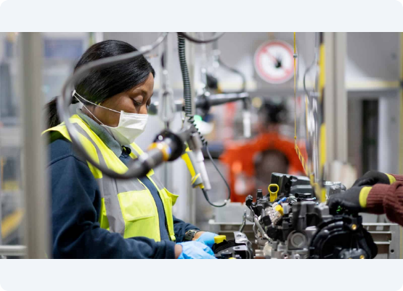
Your Learning Journey
What You Can Expect
The Pannala Factory Placement Program is designed to accelerate your growth:
Work with Experts: Collaborate daily with highly experienced industry professionals.
Contribute to Projects: Add tangible value to active, impactful business projects.
Build Workplace Skills: Develop essential soft and hard skills for your career.
Understand Operations: Gain deep, practical insights into complex factory operations.

Slide 10



Placement & Deployment
Merit-Based Opportunities
Placement Decisions
Positions are awarded purely on merit. We are looking for individuals who demonstrate exceptional potential and the drive to succeed.
Final placement decisions are comprehensively based on:
Your Core Competencies
Final Interview Performance
Current Business Requirements

Slide 11
Common Interview Questions
Prepare your thoughts around these common areas with confidence:
"Tell us about yourself." (Keep it professional and concise)
"Why Nestlé?" (Show your research and passion)
"What are your greatest strengths?" (Align them with the role)
"Can you give an example of teamwork?" (Use the STAR method)
"Describe a challenge you faced and how you overcame it."
"What are your long-term career goals?"

Slide 12
You Are Here for a Reason
75+
From Candidates to Talent
Out of more than 75 applicants who started this journey, only a select few made it to the final interview stage.
You have proven your capabilities. Now, step in with confidence and show us why you are the future talent Nestlé is looking for.
Initial Applicants

Slide 13
Best of Luck!
Confidence comes from preparation. We look forward to a great conversation.
Nestlé Lanka – Pannala Factory Placement Program

Slide 14



Image Sources
https://media.istockphoto.com/id/2207047394/photo/group-of-diverse-young-professionals-smiling-in-a-modern-office-setting.jpg?s=612x612&w=0&k=20&c=9SH_aKvalGp9E8WCthyauKrVkpQndvz0LYt8mux3AYA=
Source: www.istockphoto.com
https://media.istockphoto.com/id/953226942/photo/confident-applicant-smiling-at-job-interview-with-diverse-hr-managers.jpg?s=612x612&w=0&k=20&c=9kv51eIeG4jKxNxOY7yC_u_NrvIUAD9JZ2_mQY0Q8yg=
Source: www.istockphoto.com
https://news.clemson.edu/wp-content/uploads/2026/02/AMIC-Building_103125_AJ_033-copy-2-1400x788.jpg
Source: news.clemson.edu
https://nam.org/wp-content/uploads/2020/10/Dagenham-RTW-3_1600x900.jpg
Source: themanufacturinginstitute.org

